Slide 1
PetFinder.my Adoption Prediction
Matt Wittyngham, Arife Kart-Arslan, Matt Trehub, Sarah Brown

Slide 2
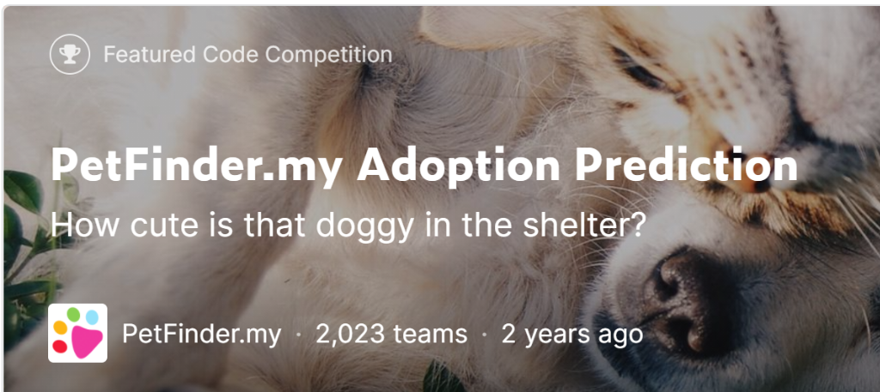
Agenda
Background on the competition
Problem Statement
Data description
Critique One
Critique Two
Solution One
Solution Two
Conclusion

Slide 3
Introduction
- Petfinder.my has been Malaysia’s leading animal welfare platform since 2008 with a database of over 150,000 animals
- Animal adoption rates are strongly correlated to the metadata associated with their profiles
- Photos
- Age
- Descriptive Text

Slide 4
Problem Statement
- Involves the creation of algorithms for the purpose of predicting the likeliness of a pet being adopted and specifically, the time in which that takes to occur
- The values ranges from 0, meaning the pet was adopted the same day it was listed on PetFinder, to a 4, an instance where no adoption had taken place after being listed for at least 100 days

Slide 5
The Data
- The data comes from pet listings on PetFinder and comes in the form of text, tabular and image data
- Split into a training and testing dataset
- Type/Breed of Animal, Color, State where the animal is coming from
- In addition, maturity, size, fur length, health statuses

Slide 6
Critique One - CHEATING SCANDAL
Notes:
https://www.kaggle.com/bminixhofer/how-bestpetting-cheated

Slide 7
Critique Two - Random Forest from Johan Wallgren
Notes:
Random Forest Analysis Doc on Dropbox

Slide 8
RF from Johan Wallgren
- Used 99% of the data for the training set sample size
- more beneficial to stick to a more traditional 80/20 split
- Unnecessary use of ggplots on features throughout script
- perhaps a good visual for themselves but not useful to actual competition submission
- Results showed that age is highest contributing feature in time it takes for a pet to be adopted
- Results indicated amount of colors/animal health did not have high importance

Slide 9
Critique Three- Another Random Forest
Notes:
### Peatfinder Dataset represents Classification Models and Regression Models
### Classification Models: Multinomial Logistic, SVM, RF (regression/classification trees)
### Comparative Models provide the best results
### Supervised Learning Models
### RF is used by different library packages (i,.e. tibble, dplyr, etc)
Data Source 1 Class-Codes (Just given mse, OOB with confusion matrix, Relative variable importance plots)
Data Source 2 Kaggle (Just given mse, OOB with pred error and confusion matrix, Relative variable importance plots)
Data Source 3 Class-Kaggle (just given plots about other variables i.e. health, size, color, etc.)

Slide 10
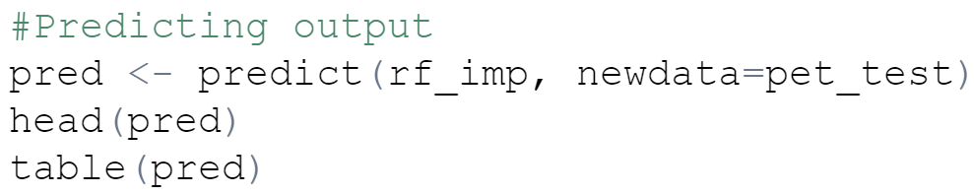
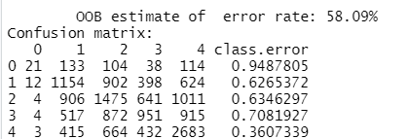
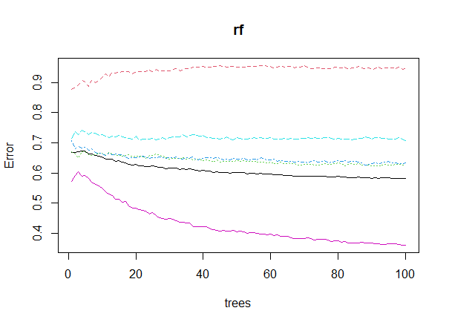
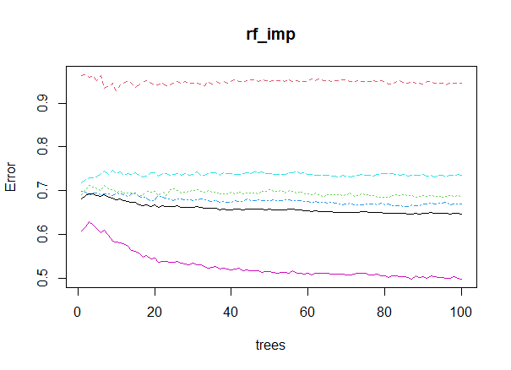
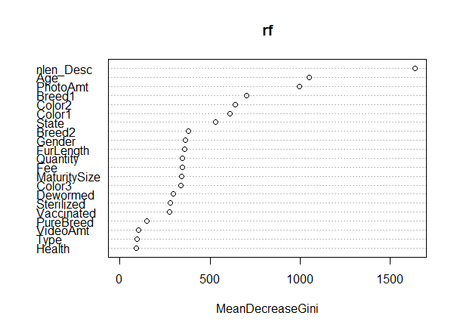
RF by Akshata Kanumuri
- Data Source 2 Kaggle
They only provide mse, we want classification
Confusion matrix
Relative variable importance plots
Out of bag random forest
We only saw this in this particular data source

Slide 11
Our Solution #1 - SVM

Slide 12
Our Solution #2 - SVM

Slide 13
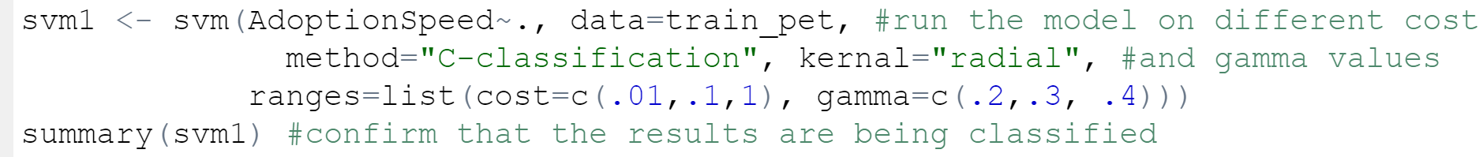
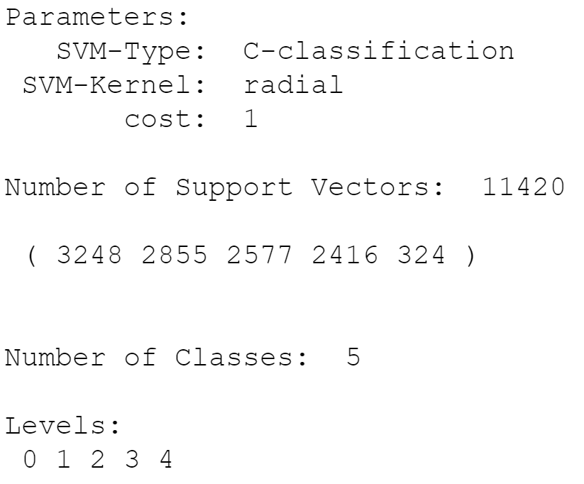
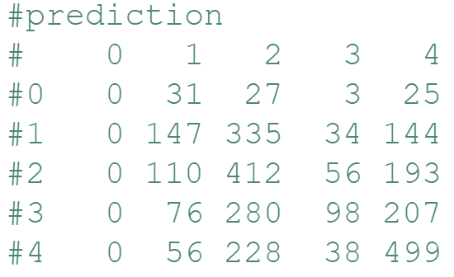
SVM 2 Solution
SVM Model 1
- Very similar to what Matt just explained
- SVM tuning was different (see comparison images)
-Accuracy slightly higher 38.5% - best model
- Reproducibility, lots of comments
- demonstration of the code
SVM Model 2

Slide 14
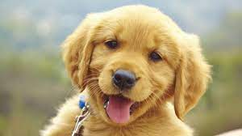
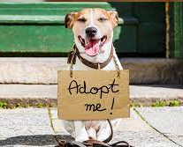
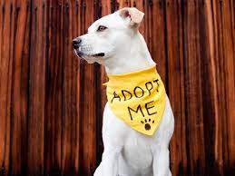
Conclusion
- SVM was most efficient for us - Random Forest or logistic regression is also possible - Things like ridge or lasso would have to be multinomial - we tried this, but ran into memory issues - Careful with conversion to factors - Seeing different approaches was helpful to see how some of what we have learned in the classroom is applied in these ‘real world’ scenarios/competitions

